Slide 1
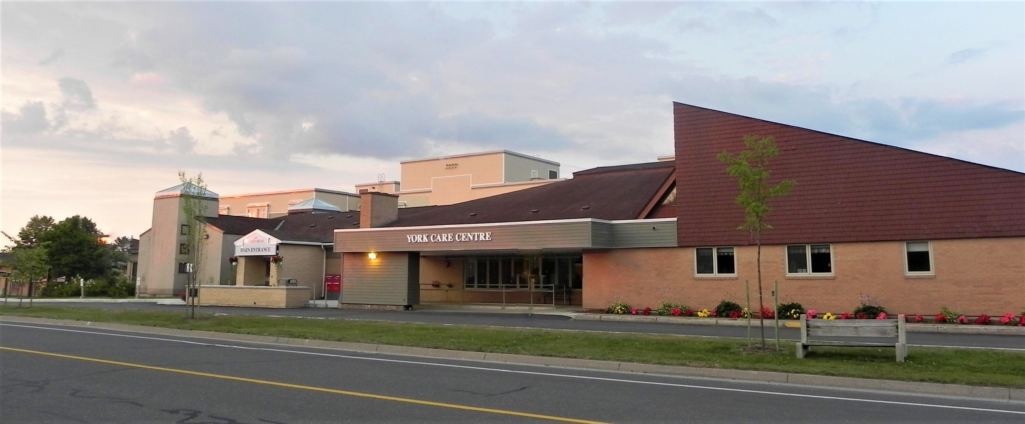



YCC Board of Directors
Orientation
December 2023

Slide 2
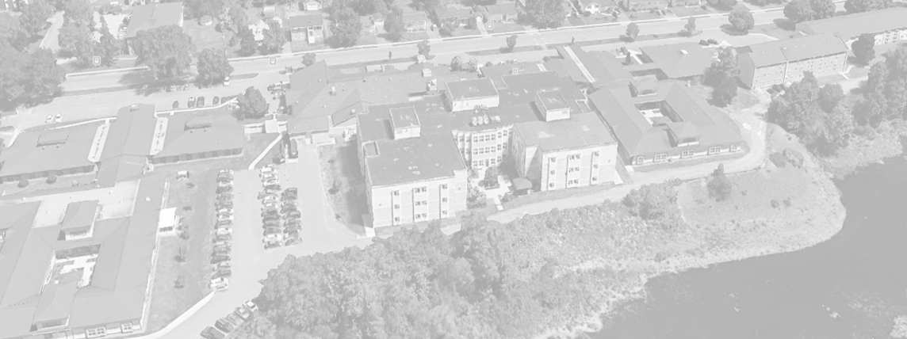
Part 1
THE COMPANIES

Slide 3
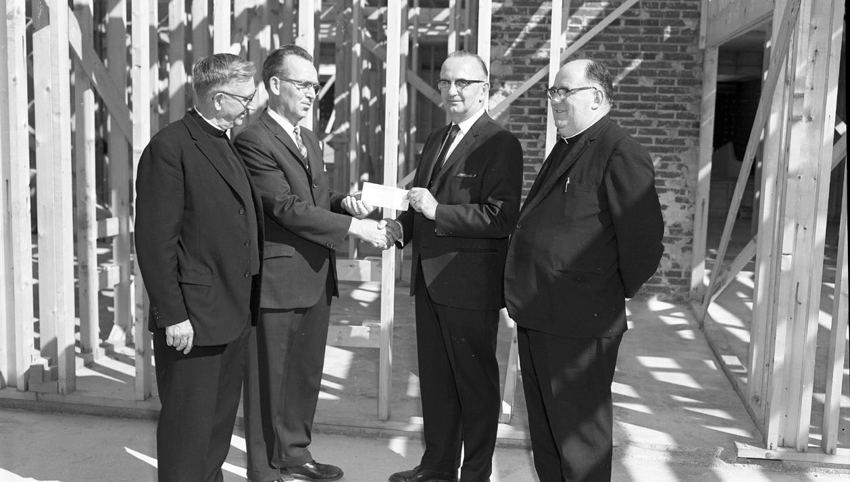
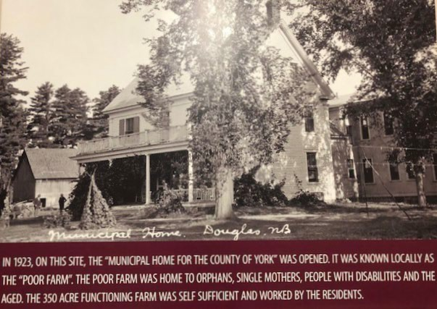
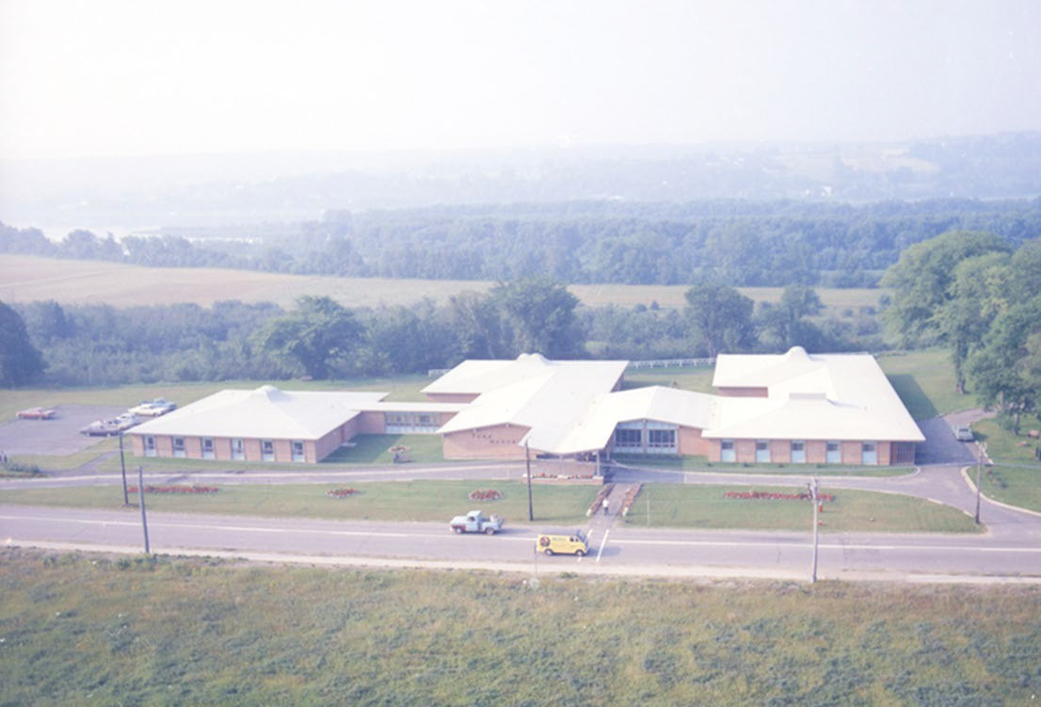
The Companies
Where it All Started
Cornerstone Ceremony, October 1967
August 1970

Slide 4


















York County Properties Inc.
Primary Focus
Holding Company
$20,000
0
0
Interest, Miscellaneous
Annual Budget
Number of Employees
Number of Beds/Units
Primary Revenue Source(s)

Slide 5

















Primary Focus
Long term care
Annual Budget
$24,000,000
Number of Employees
310 ⁺
Number of Beds/Units
218 (includes 2 respite beds)
Primary Revenue Source(s)
Social Development
Resident Services
Café Sales

Slide 6
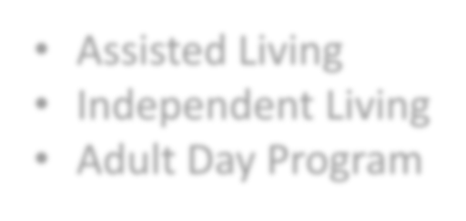















Assisted Living
Independent Living
Adult Day Program
Primary Focus
Annual Budget
Number of Employees
Number of Beds/Units
$1,490,000
16
72 Independent Living
31 Assisted Living
Primary Revenue Source(s)
Rental Income
Adult Day Program Fees

Slide 7

















Primary Focus
Research
Annual Budget
$670,350 (current)
Number of Employees
6 CIRA employees
Number of Beds/Units
None
Primary Revenue Source(s)
Healthy Seniors Pilot Project
Centre for Aging and Brain Health Institute (CABHI)
New Brunswick Health Research Foundation (NBHRF)
New Brunswick Innovation Fund

Slide 8
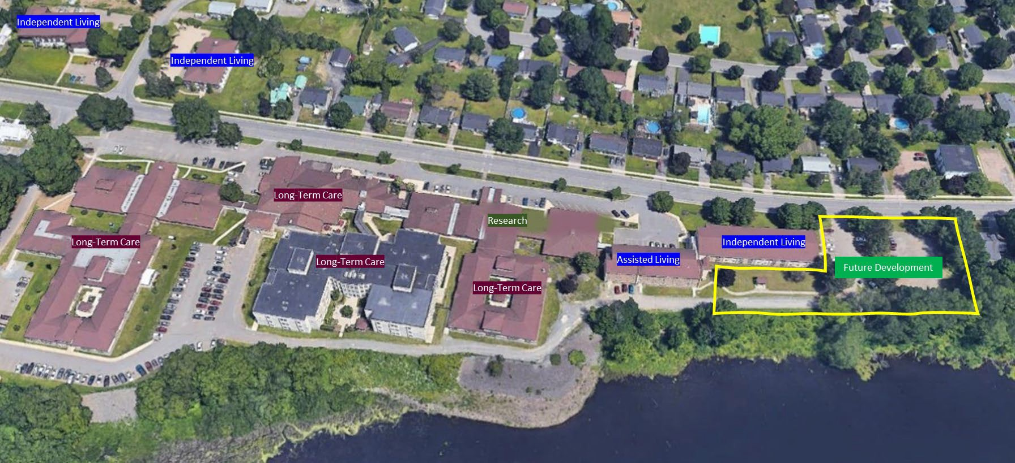
The Companies
What it Looks Like Today

Slide 9
Part 2
THE BOARD

Slide 10
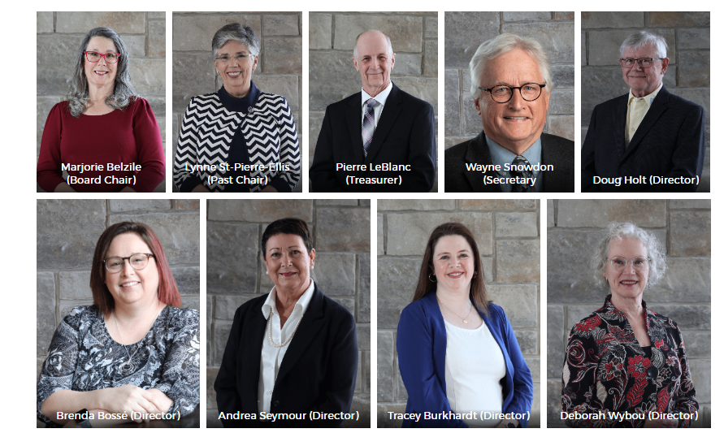
Provides oversight of YCC, YDI, YCP, and CIRA.
Follows modern governance practices.
Guided by corporate bylaws and 42 board level policies.
Four Standing Committees of the board.
The Board has an executive which includes the Chair, Vice-Chair, Secretary, and each of the Standing Committee Chairs.
Has one direct report – the President & CEO.
The Board of Directors

Slide 11
The Board Committees
Chair: Lyne St-Pierre-Ellis
CARE & RESIDENT SERVICES COMMITTEE
Review/recommend policies related to resident care and services
Receive and review reports: (CQI, VP Quality and Care, Resident Council, Family Advocacy Group)
Receive/review documents related to resident care e.g. Quality of Life Survey
Monitor Strategic Plan implementation & reporting: Care Services Pillar
Chair: Deborah Wybou
GOVERNANCE & AUDIT COMMITTEE
Review/develop Governance policies
Nomination & orientation of new Board members
Planning Board education
Conduct annual Board & Committee assessments
Review and monitor Nursing Home annual inspections
Review annual Audit.
Review & recommended changes to Bylaws
Monitor Strategic Plan implementation & reporting: Partnership Pillar
Chair: Tracey Burkhardt
RESEARCH & ETHICS COMMITTEE
Chair: Pierre LeBlanc
FINANCE & ADMINISTRATION COMMITTEE
Review for approval all research projects involving York Group of Companies
Grant submission for initial submission of research proposals
Monitor approved, and revoke ethic approval where appropriate
Review ethics issues brought forward, and develop/revise policy and/or procedures
Monitor Strategic Plan implementation & reporting: Research Pillar
Review & approve annual operating budgets
Review and approve financial statements
Receive and approve report from VP People & Culture, and Director Facilities, Infrastructure & IT
Monitor Strategic Plan implementation & reporting: Resources & Environment Pillars

Slide 12
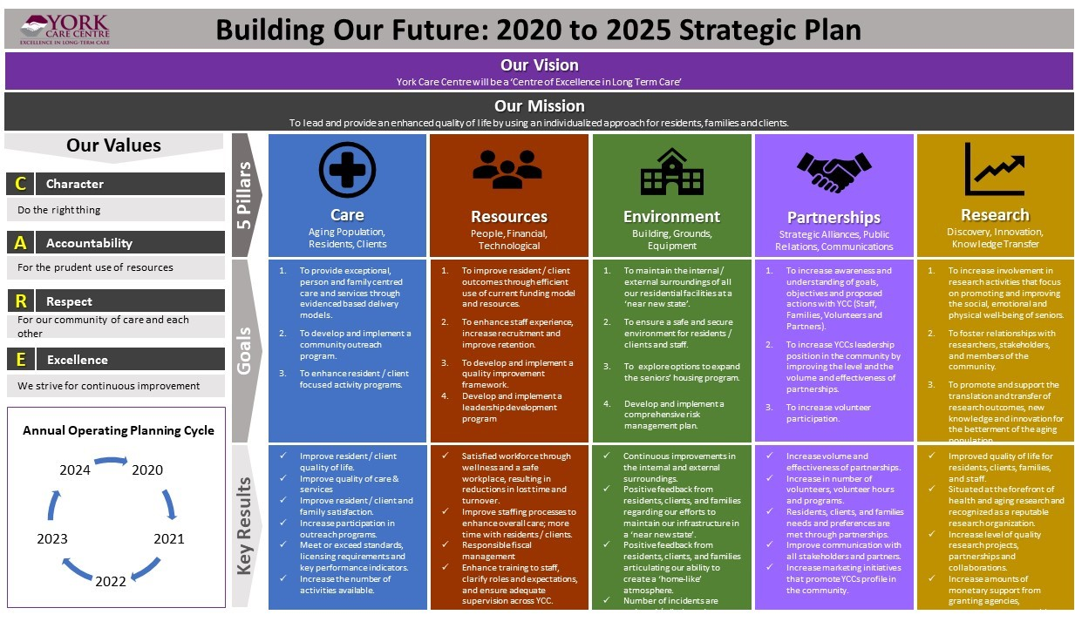
The Board - The Strategic Plan

Slide 13

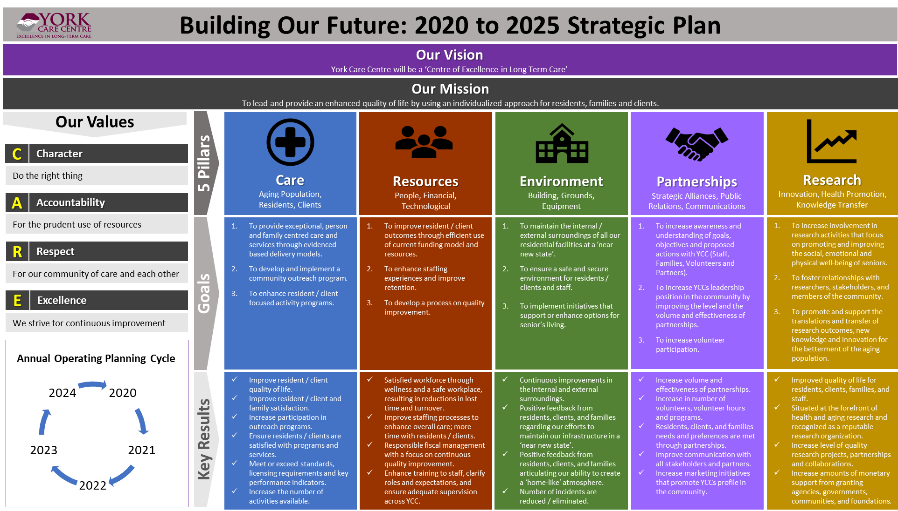
The Board
Annual Operating Goals
Annual Operating Goals are prepared by the senior leadership team.
Progress is reported quarterly to board committees.
2023-24

Slide 14
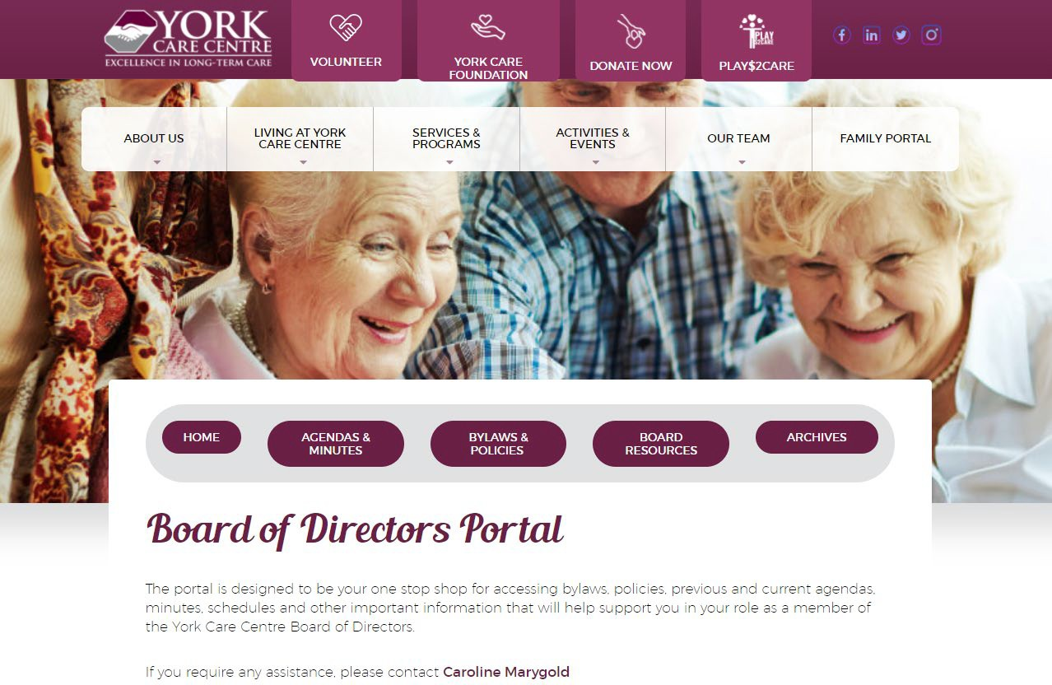
The Board
The Board Portal
The Board Portal is accessible via our main website, under Our Team.
To access the Board Portal: www.yorkcarecentre.ca
The Portal is where we place past and current Board Meeting packages as well as Bylaws, etc.

Slide 15
Part 3
York Care Foundation Board

Slide 16
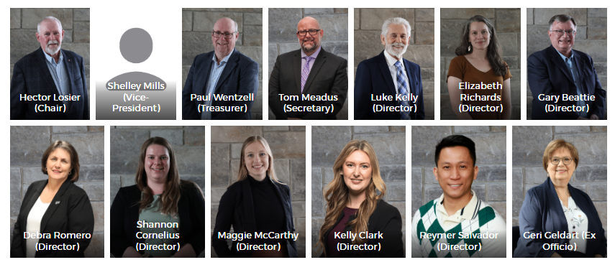
The York Care Foundation
Board of Directors
Founded in 2007 – a Fundraising Board which supports York Care Centre.
Independent board that operates with its own bylaws.
Management provided by YCC staff.
Current board chair, Hector Losier.
Ten additional board members with broad professional, legal, private, public-sector backgrounds.
Seeking new members

Slide 17


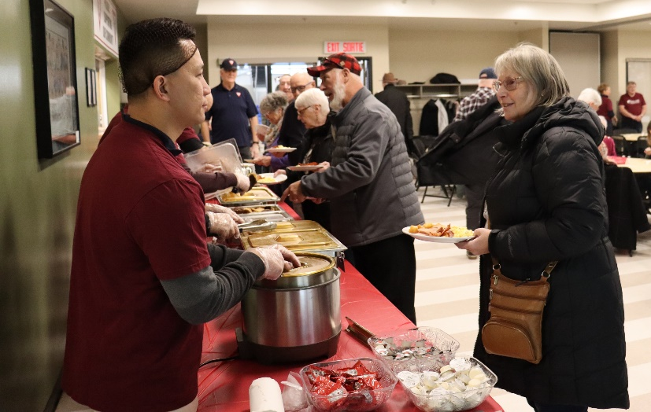

The York Care Foundation Board
Current Fund-Raising Examples
Annual Golf Fore Care tournament ($19,000 net raised this year)
Annual Laugh for Care Gala ($12,000 net raised for this year)
Bingo - ($2,700 raised) + FUN
Donations, Lotteries & Other Fundraisers ($10,000+ in donations and other fund-raisers)

Slide 18


Slide 19
Part 4
Senior Leadership Team

Slide 20
The SLT & Organizational Structure
Board of Directors
York Care Foundation
Board of Directors
President and CEO
Geri Geldart
Executive Assistant & Board Coordinator
Jennifer Vos
Marketing & Communications
Tara Thibault
Vice President, Quality & Care Services
Jamie Roy
Vice President, People & Culture
Shelley Kenny
Chief Financial Officer
Heather Harris-Jones
Director, Facilities & Infrastructure
Michel Boyer
Exec Director, C.I.R.A.
Justine Estey
Medical Director Dr.Irrinki
Organizational Chart
November 2023

Slide 21
Part 5
RESIDENT, TENANTS &CLIENTS

Slide 22
The Organizational Structure – Care Services
YCC/CIRA/YDI
Board of Directors
President & CEO
Geri Geldart
York Care Foundation Inc.
Board of Directors
Executive Assistant & Board Coordinator
Jennifer Vos
Vice President Care Services & Quality
Jamie Roy
Director of Care
Tamsen Arnold
Manager, Community, Recreation & Volunteers
Stephanie Seymour
Infection Control Resource Nurse
Rose Chase
Clinical Informatics & InterRAI Specialist(s)
Registered Dietician
Lynne Morrison
Unit Coordinator, Tower 1 & 3 Jason Robin
Spiritual Care Coordinator Norm McDonald
Unit Coordinator, Dixon
Ashley Atkinson (temp)
Adult Day Program & Hawkins House
Candace Purcell
Unit Coordinator, Birch Grove & T2 Melanie Castillo
Rehabilitation Staff
Nursing Unit Clerks
Organizational Chart
November 2023

Slide 23








Residents, Tenants, and Clients
Assessing Type of Care Required
Social Development conducts assessments.
For those whose ability to carry out normal daily activities on a long-term basis is limited.
A standardized assessment criteria ensures that all seniors with long- term care needs have equal access.
Assessments are undertaken to determine the level of care required.
The four levels of care
Clients are generally mobile but require the availability of supervision on a 24- hour basis related to their personal care.
1
2
3
4
Clients may require some assistance or supervision with mobility and require more individualized assistance or supervision on a 24-hour basis with personal care and their activities of daily living.
Clients have a medically stable physical or mental health conditions or functional limitation and require assistance and supervision on a 24-hour basis.
Clients have difficulties with cognition and/or behaviour requiring supervision and care on a 24-hour basis. Clients may display aggressive behaviour toward self and/or others. Most often they need maximum assistance with their personal care and activities of daily living - often they also require medical care .

Slide 24
Residents, Tenants, and Clients
Options for Care
In-Home Support
Special Care Homes
Nursing Homes
In-home support services consist of non- professional assistance with personal care needs such as help with dressing, bathing, and grooming; assistance with housekeeping tasks which may include activities such as cleaning, laundry, meal preparation, and respite care.
These services are provided largely through third-party contracts with home support agencies.
Currently Social Development provides assistance to about 4,700 seniors who are receiving in-home support services.
Special care homes provide services to seniors who require low to moderate levels of care on a regular basis.
There are 425 special care homes providing residential services to about 2,675 seniors assessed as requiring Level 1 and 2 care.
Special care homes are privately- operated, for-profit facilities.
Nursing homes provide service to those whose primary need is for nursing care; that is those adults who are assessed as needing Level 3 and 4 care.
There are 71 nursing homes in New Brunswick serving about 4,900 adults .
The majority of nursing homes are not- for-profit organizations that are privately owned and operated by a volunteer board of directors.
Social admissions may be used when a person is requesting to be with his/her spouse or significant other.

Slide 25
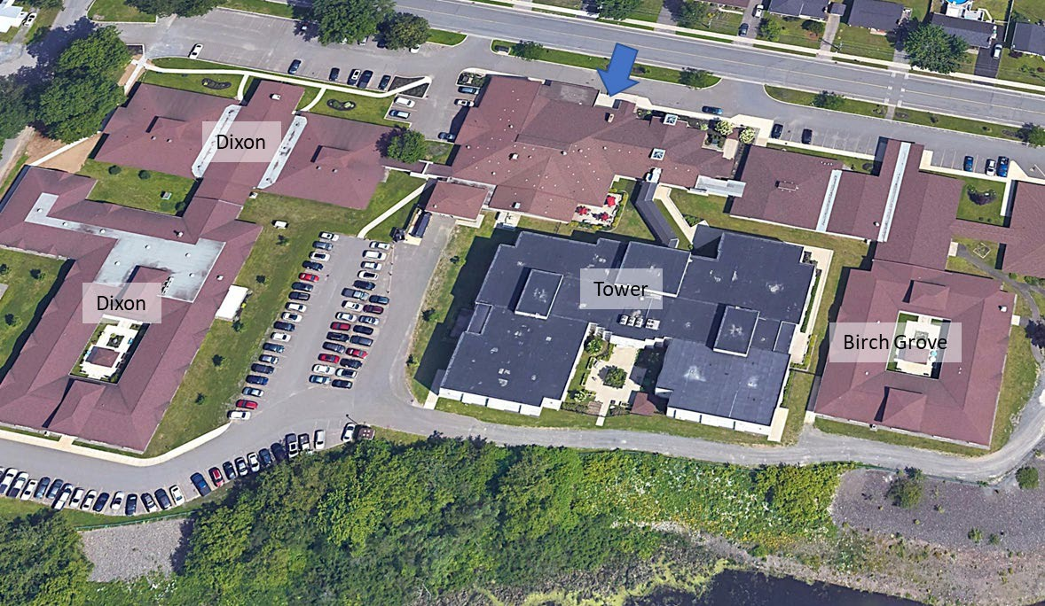
Residents, Tenants, and Clients
Long-Term Care Residents
216 Rooms: 90% private,
10% semiprivate
• +2 Relief Care beds
5 Units: Birch Grove, Tower 1, Tower 2, Tower 3, Dixon
Pets: cat, rabbit, guinea pigs, love birds, dogs who visit

Slide 26
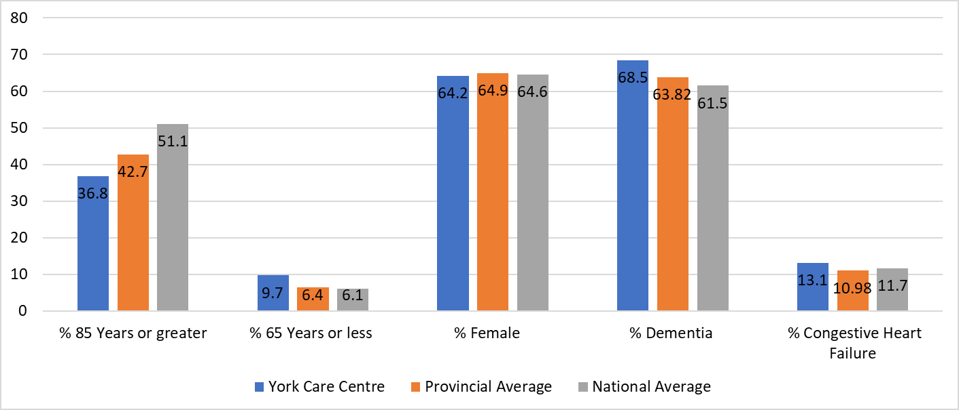
Residents, Tenants, and Clients
Facility Characteristics

Slide 27
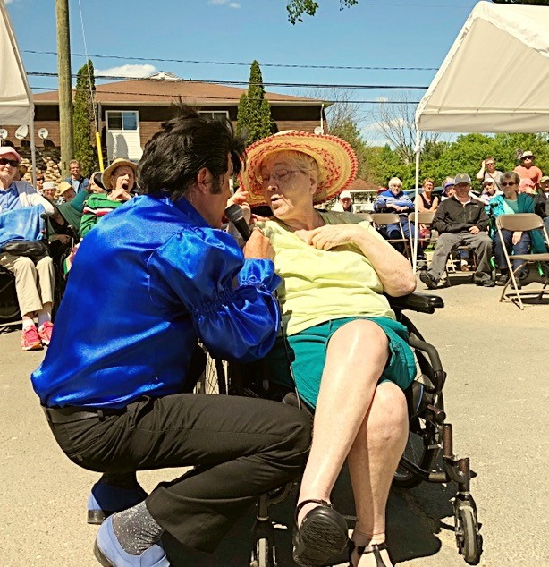
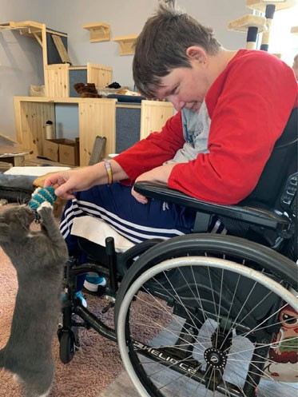
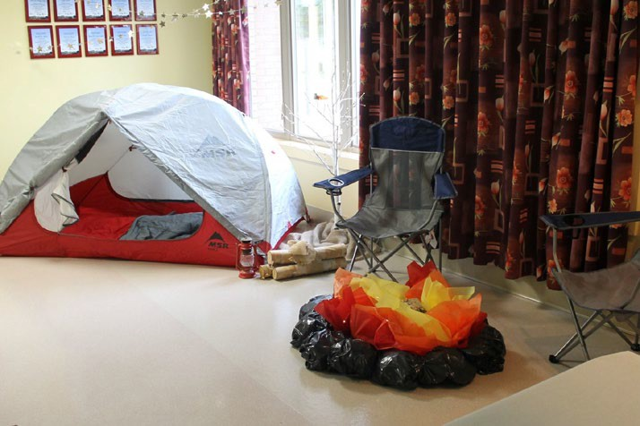
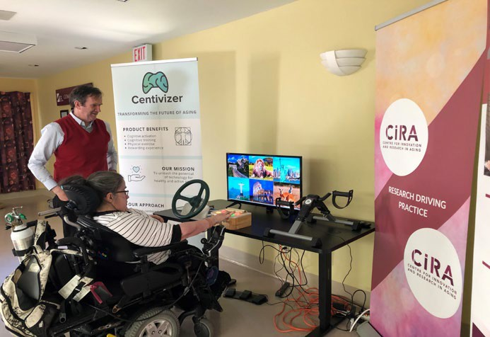
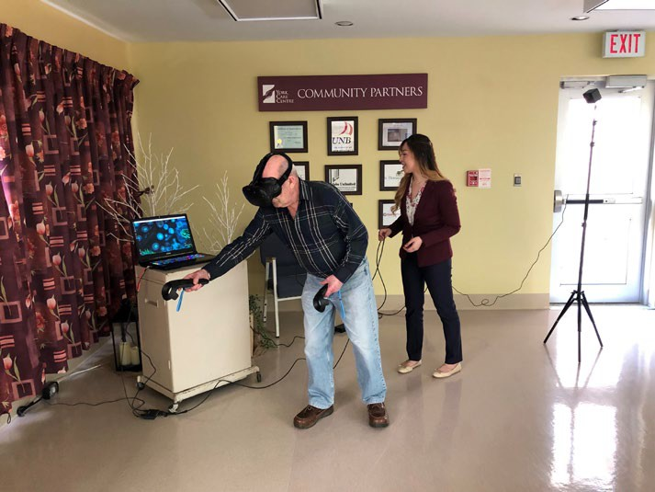
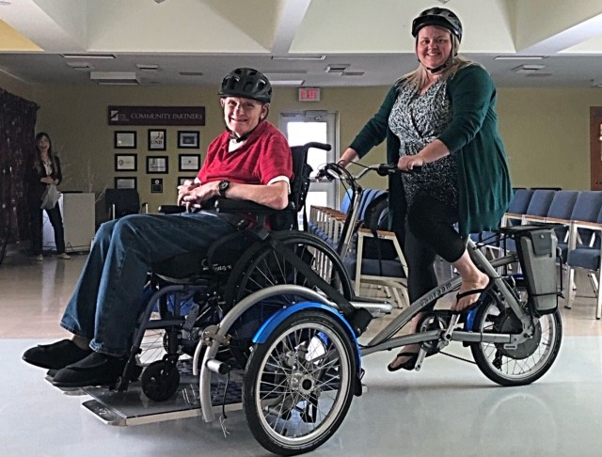
Residents, Tenants, and Clients
Resident Activities
160
Average monthly activities held for residents

Slide 28
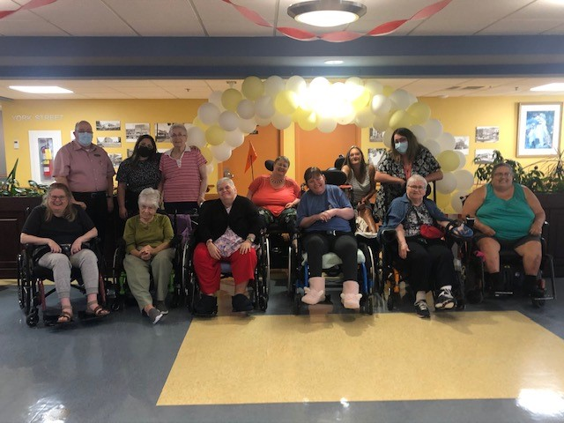

Residents, Tenants, and Clients
Resident Council & Family Advocacy Committee

Slide 29
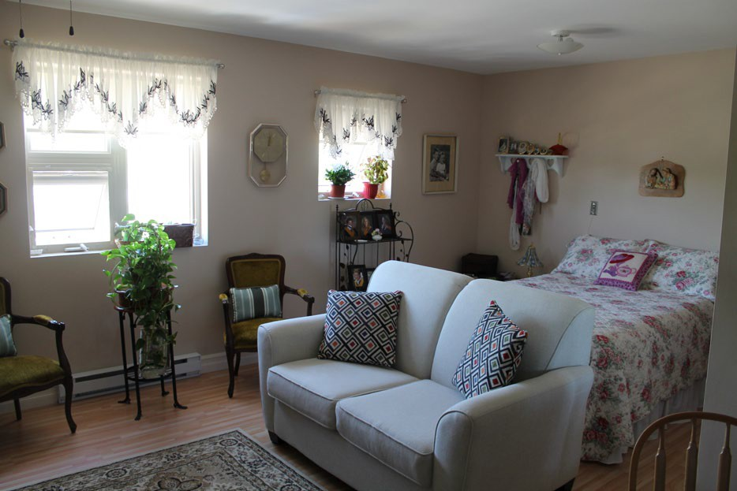
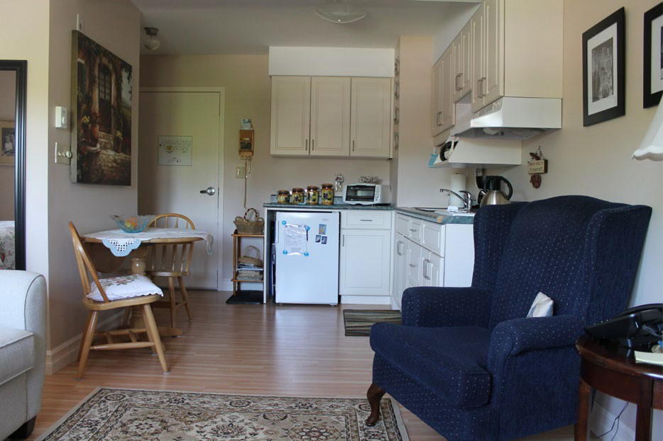
Residents, Tenants, and Clients
Supportive Living
Tenants must be over 60
31 Studio apartments
Very social, tenants come together for meals
Services include weekly room cleans, weekly laundry, 2 meals daily in common dining room (lunch & supper), security cameras, security personnel, and 2 call bells in each unit for emergencies, 24 hr response
Tenants may apply to receive up to 2hrs of personal care/day, which would be provided by our care staff.

Slide 30
Residents, Tenants, and Clients
Independent Living
Tenants must be over 55
3 Apartment Buildings, housing 72 tenants
Both 2 bedroom and 1-bedroom apartments
Must be able to live independently without additional supports.

Slide 31
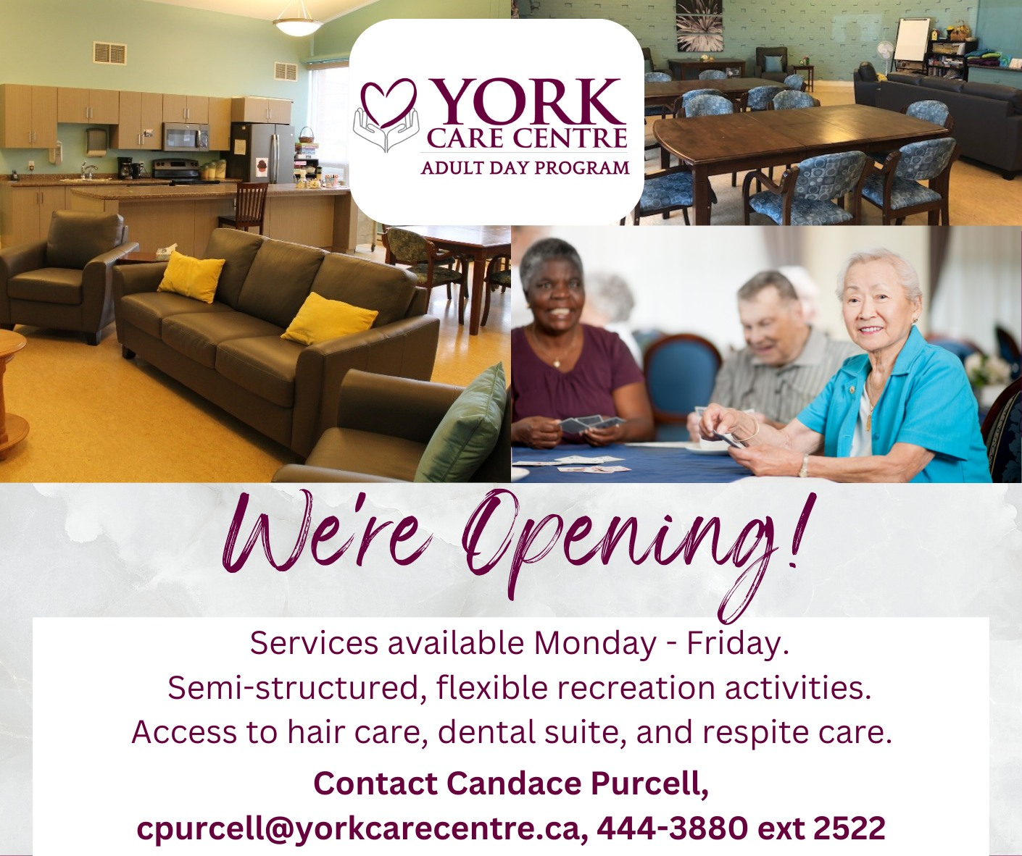
Residents, Tenants, and Clients
The Adult Day Program
Offers care and support to individuals and families on their journey with dementia and other diseases in a non-institutionalized setting
Enhances the client’s social engagement level by participating in a meaningful program in a structured yet flexible environment.

Slide 32
Part 6
WORKFORCE OVERVIEW

Slide 33
The Organizational Structure – People & Culture
President & CEO Geri Geldart
Executive Assistant & Board Coordinator
Jennifer Vos
Vice President, People & Culture
Shelley Kenny
Receptionist
Dawn Comeau
Manager, Human Resources Jennifer Geneau
Employee Scheduling Specialist Marj Jellema
HR Analytics & Benefits Specialist
Allie Fraser
Organizational Chart
November 2023

Slide 34

















Workforce Overview
Workforce Demographics
310⁺
Employees
Administrative | 5%
Care Services | 63%
Support Services | 26%
Other | 6%

Slide 35
























Workforce Overview
Workforce Demographics
 | 310+ Employees
38% | 18 to 39 Years | 9%
33% | 40 to 59 Years | 9%
4% | 60 to 64 Years | 2%
3% | 65+ Years | 2%

Slide 36
Workforce Overview
Recruitment
Most Common Recruitment Platforms:
Indeed / Career Beacon
NBCC Web site
Eastern College
YCC Web site
Refer a Friend program
YCC Facebook
LinkedIn
Student Placements

Slide 37

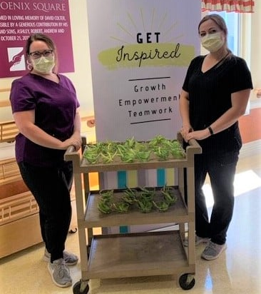
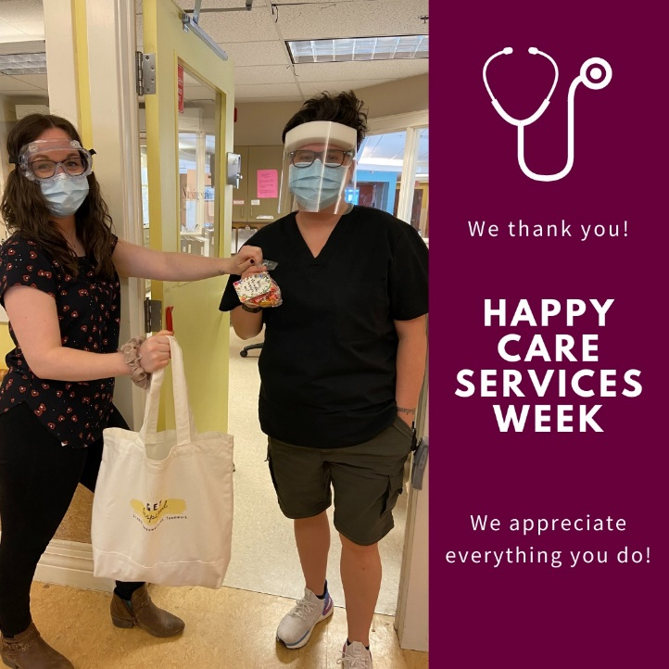

Workforce Overview
Investing in Employees
GET Inspired Committee
Fitness Centre
Refer-a-Friend
Scholarship Programs
Real-time Recognition
Years of Service Awards
Resident Attendant Program
Professional Development Opportunities

Slide 38
Part 7
HOW THE
FUNDING FLOWS

Slide 39
The Organizational Structure
Finance & Accounts
President & CEO Geri Geldart
Executive Assistant & Board Coordinator
Jennifer Vos
Chief Financial Officer Heather Harris-Jones
Senior Accountant Kathy Palmer
Accountants Receivable Specialist
Dee Hunter
Accounts Payable & Procurement Specialist Renee Lowe
Organizational Chart
November 2023

Slide 40
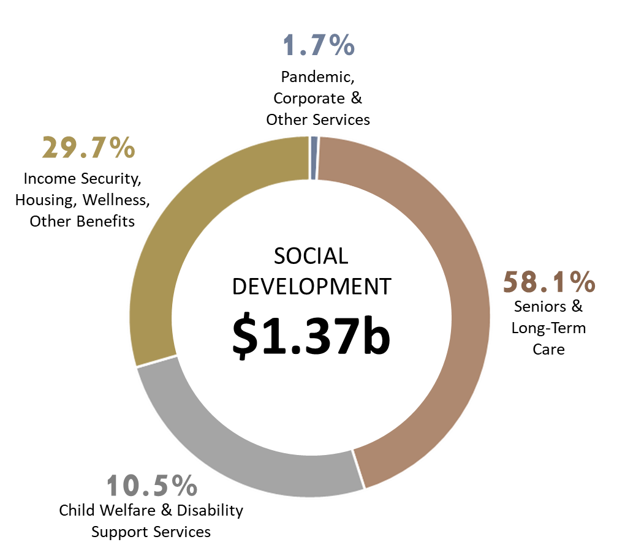

How the Funding Flows
Social Development to Nursing Home Regions
Adult protection, home support, adult residential facilities, adult day centres, disability, aging strategy
49%
0.8%
51%
30.0%
SENIORS & LONG-TERM CARE
$860.5m
58.6%
Nursing Home Services
$1.47B
49% $422M
10.6%
*Based on 2021-2022 GNB budget

Slide 41
How the Funding Flows
Social Development to YCC: 2022-23 Fiscal Year
Wages and Benefits | $16,932,587 | 257 FTEs
Other Expenses | $ 3,327,375
Mortgages and Loans | $ 2,606,931
Subtotal | $22,866,863 | $287 per resident day
Add’l Safe Restart Funding Q1 & Q2 | $ 81,446
Total SD Funding Excl Budget Amend | $22,948,309

Slide 42
Other Sources of Revenue for YCC
2022-23 Fiscal Year
Inter-Co Chargebacks to YDI and CIRA Amortization of Deferred Contributions Care services revenue and rebates | $ 361,723 $ 300,532 $ 100,024
Recoveries from phone, cable internet, van usage | $ 91,429
Cafeteria, dietary sales/rebates Education Grants | $ 85,480 $ 50,000
Administration revenue and bank interest | $ 54,025
Summer Student Grants | $ 27,000
Total Other Revenue | $1,070,213

Slide 43
Other Budget Factors for YCC
Maximum paid by resident is $113 per day or $3,437 per month
The actual charge is based on income assessments done by Social Development
For low income residents we pay them $108 per month to cover comfort & clothing items (14 residents currently)
Social Development deducts the revenue paid by residents from the $22.9 million budget
SD provides additional funding through budget amendments to cover retirement allow, mat leave, add’l care hours, capital repairs etc.

Slide 44
Other Company Budgets
York Developments Inc. operates seniors apartments, assisted living apartments and an Adult Day Program.
Centre for Innovation and Research in Aging Inc. carries out various research projects.
York County Properties Inc. holds a mortgage for YDI.

Slide 45
Part 8
FACILITIES & PROJECTS

Slide 46
The Organizational Structure
Facility Services
President & CEO
Geri Geldart
Executive Assistant & Board Coordinator
Jennifer Vos
Director, Facilities & Infrastructure Michel Boyer
Manager, Support Services
Tommy Chapman
Supervisor, Maintenance Services Jeremy Johnson
Capital Planning & Projects
Organizational Chart
November 2023

Slide 47
Facilities & Projects
Support Services
Maintenance:
Maintain facilities and infrastructure to ensure a safe, comfortable, and homelike environment
Laundry:
750,000 pounds of laundry a year, with approximately one quarter being personal clothing
Housekeeping/Utility:
All rooms cleaned/sanitized, waste removed, and supplies delivered daily
Dietary:
All meals prepared inhouse and served on the units

Slide 48
Facilities & Projects
Recent Projects & Equipment Upgrades
Paving of the Fire Road
Fire Alarm System Upgraded Roof Repairs – Dixon and B.G.
New Generator
Parking Lot Lighting – underway
Dietary Equipment – Freezer and Burloge Oven)
Laundry Equipment – Washer
Public Address System
Resident beds
IT Upgrades

Slide 49
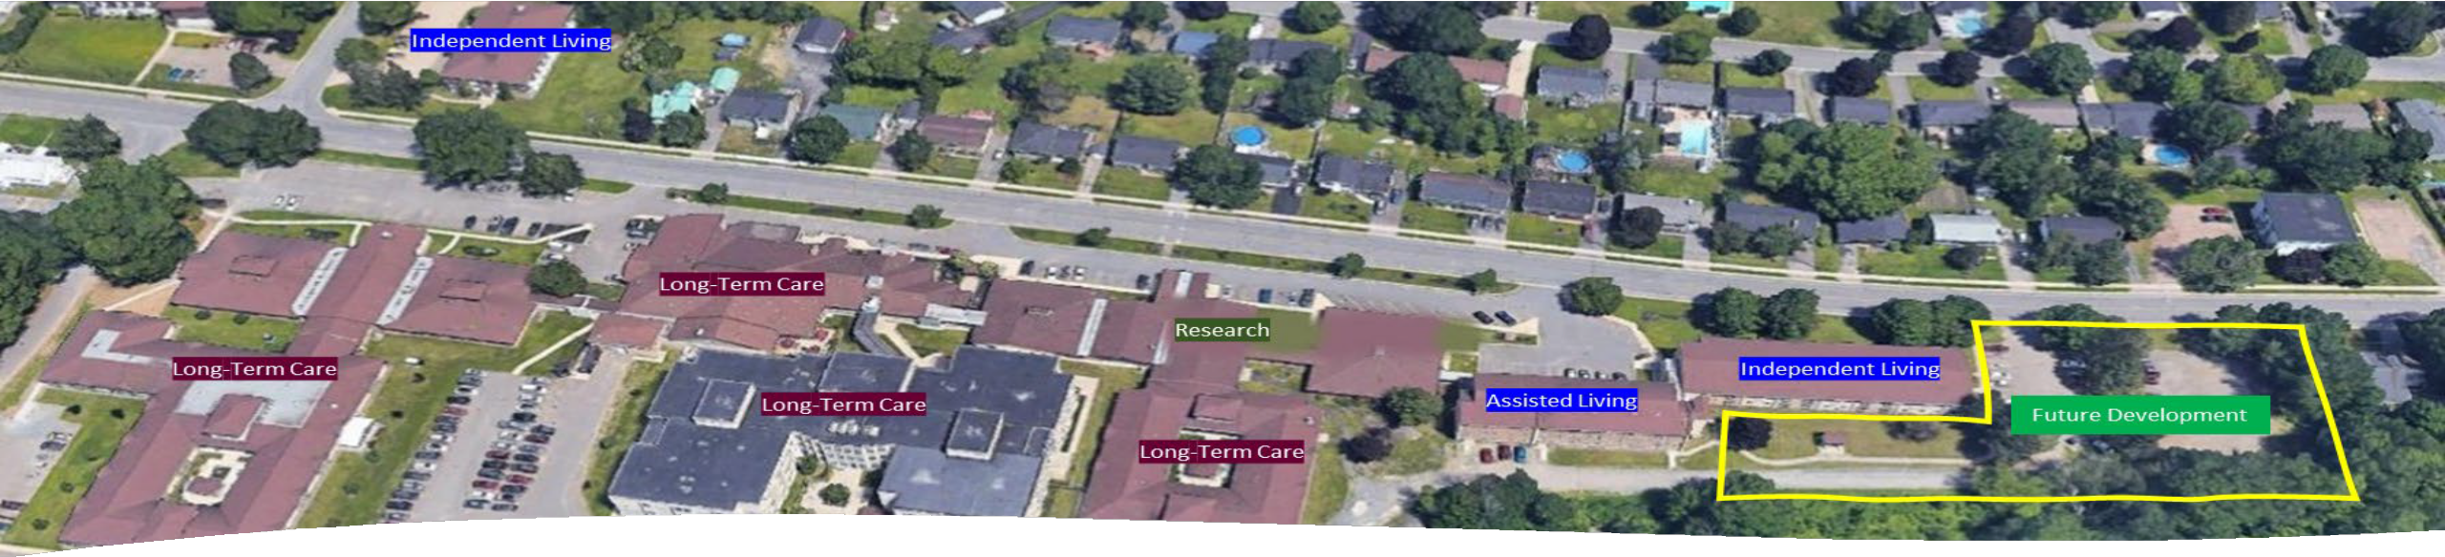
Facilities & Projects
The Wetlands Project
The Board has explored options for further site development.
Project placed on hold in 2021 due to escalating costs.

Slide 50
Part 9
AGING RESEARCH

Slide 51
The Organizational Structure – Research
YCC/CIRA/YDI
Board of Directors
President & CEO Geri Geldart
York Care Foundation Inc.
Board of Directors
Executive Assistant & Board Coordinator
Jennifer Vos
Executive Director,
Centre for Innovation and Research in Aging Justine Estey
Innovators & Research Partners
Research Coordinators
Organizational Chart
November 2023

Slide 52



Aging Research
Our Team: Collaborative, Diverse, Driven
Research assistants and coordinators, research therapist, volunteers
Research partners, collaborators, and stakeholders nation-wide

Slide 53

Our Research
Innovation, Health Promotion, Knowledge Translation
Virtual Reality for Rehabilitation
To learn more about this project, go to: www.agingresearch.ca

Slide 54

Our Research
Innovation, Health Promotion, Knowledge Translation
MedReviewRx
To learn more about this project, go to: www.agingresearch.ca

Slide 55

Our Research
Innovation, Health Promotion, Knowledge Translation
Palliative e-Learning
To learn more about this project, go to: www.agingresearch.ca

Slide 56

Our Research
Innovation, Health Promotion, Knowledge Translation
CanImmunize
To learn more about this project, go to: www.agingresearch.ca

Slide 57
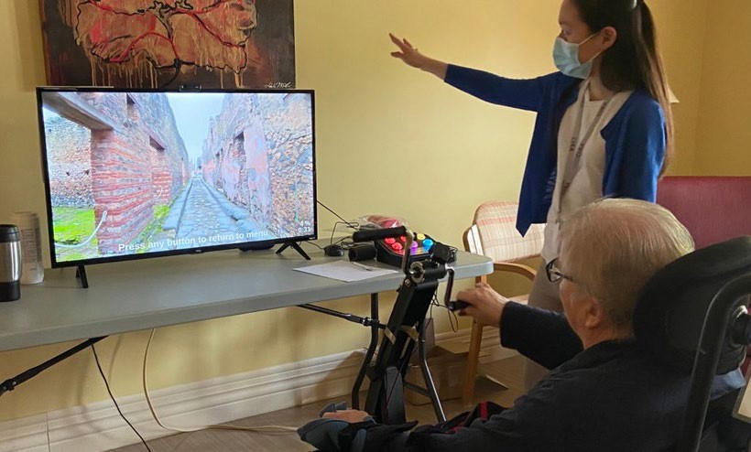
Our Research
Innovation, Health Promotion, Knowledge Translation
2RaceWithMe
To learn more about this project, go to: www.agingresearch.ca

Slide 58
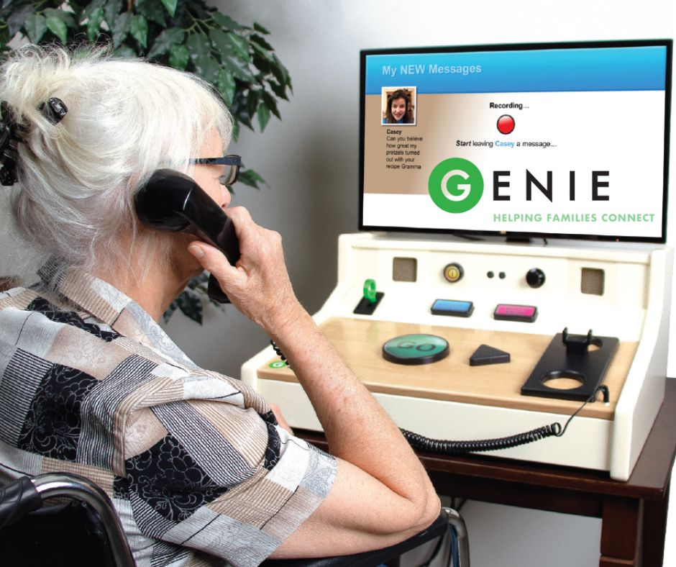
Our Research
Innovation, Health Promotion, Knowledge Translation
Genie
To learn more about this project, go to: www.agingresearch.ca

Slide 59

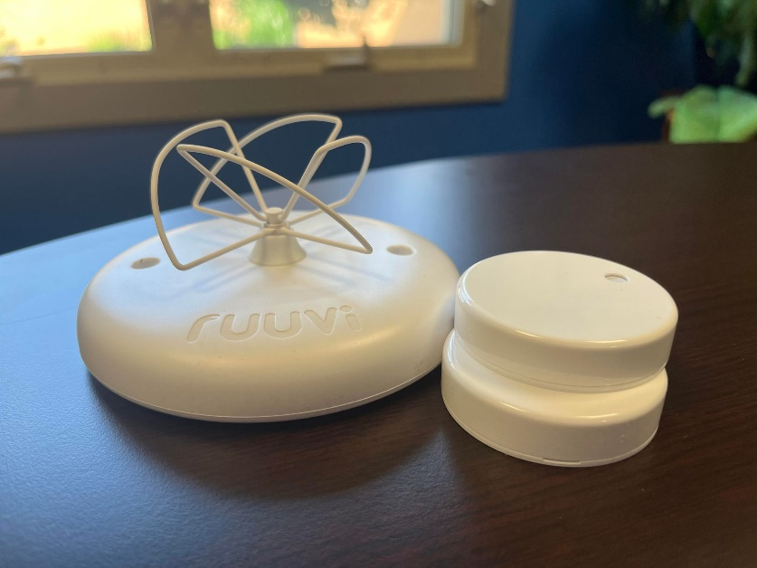
Our Research
Innovation, Health Promotion, Knowledge Translation
Passive Aware
To learn more about this project, go to: www.agingresearch.ca

Slide 60
Due for Review
Part 10
WEBSITES &
SOCIAL MEDIA

Slide 61
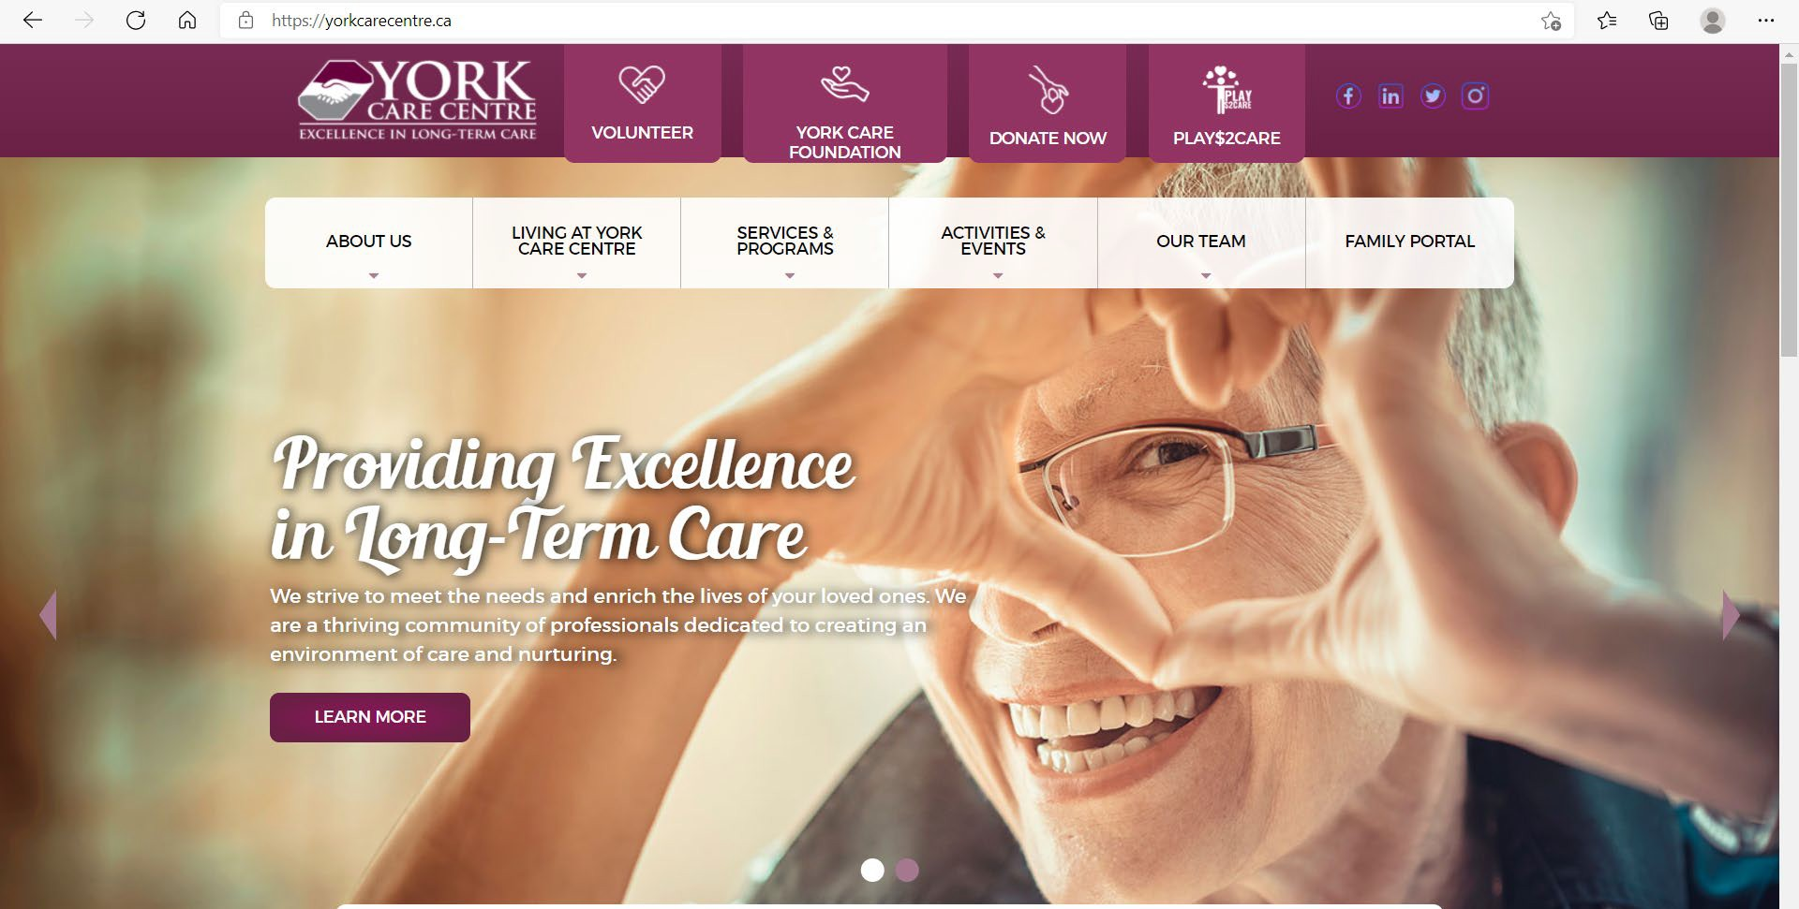

Our Companies
Websites
Due for Review
www.yorkcarecentre.ca
www.agingresearch.ca

Slide 62




Our Companies
Social Media
York Care Centre: @YorkCareCtr CIRA: @AgingResearchCA
York Care Centre: @YorkCareCentre CIRA: @AgingResearchCA
Ask Justine
York Care Centre: @YorkCareCentre CIRA: @AgingResearch

Slide 63
Part 11
PERFORMANCE REPORTING

Slide 64
Performance Reporting
Strategic Scorecard

Slide 65







Performance Reporting
Clinical Reporting Overview
A consortium of US/Canadian LTCs that drill down into problematic areas of mutual concern
Social Development
Electronic Health Record
YCC Care Provider
YCC Resident Assessment Instrument (RAI) Coordinator
www.yourhealthsystem.ca

Slide 66
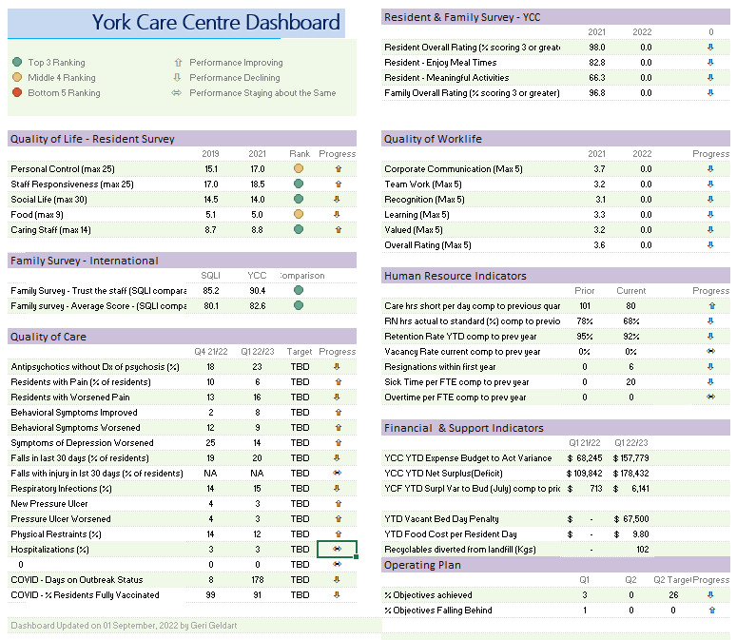
Performance Reporting
Key Performance Indicators

Slide 67
Part 12
THE NB LONG-TERM CARE LANDSCAPE

Slide 68
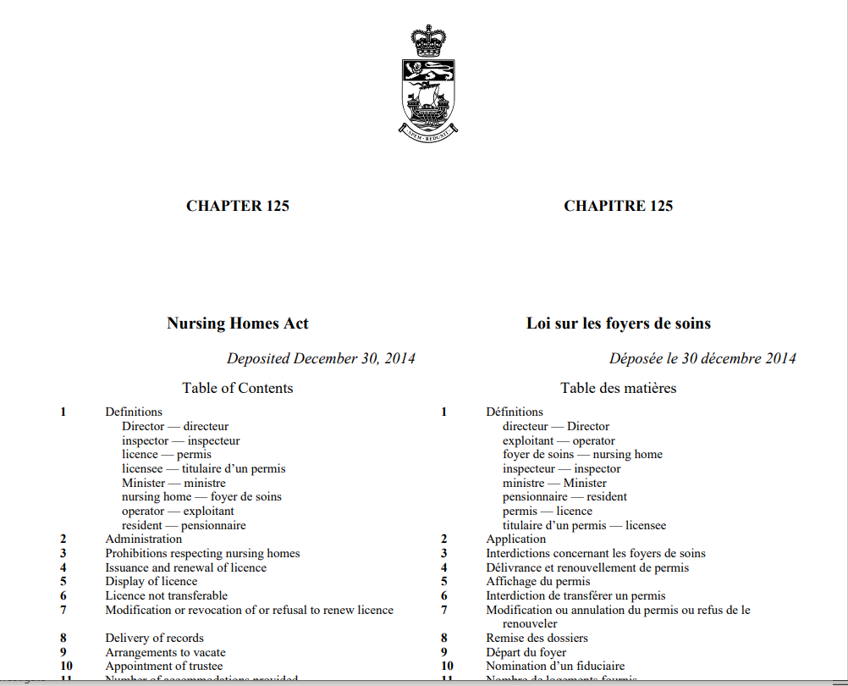
The NB Long-Term Care Landscape
Provincial Regulation
LEGISLATION
Nursing Home Act
REGULATIONS
85-187 General
DEPT. OF SOCIAL DEVELOPMENT
        Adult Community Resources.

Slide 69
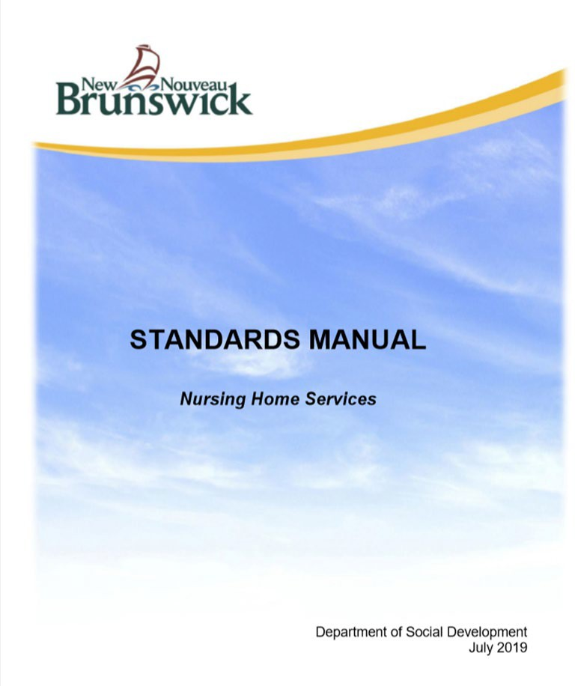
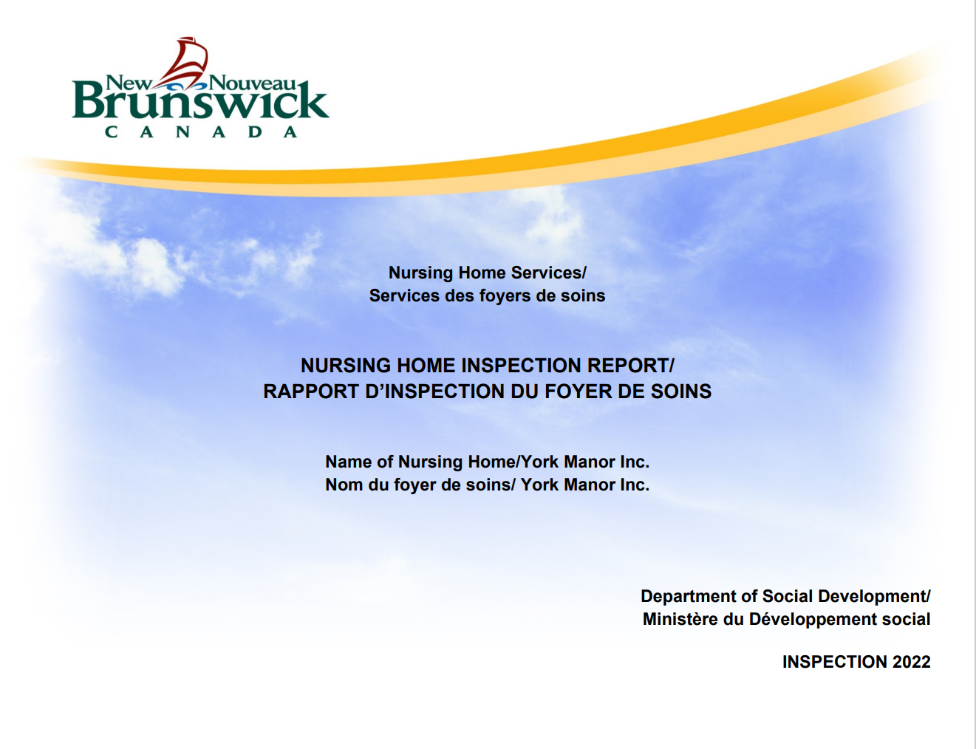
The NB Long-Term Care Landscape
Nursing Home Services: Standards Manual

Slide 70
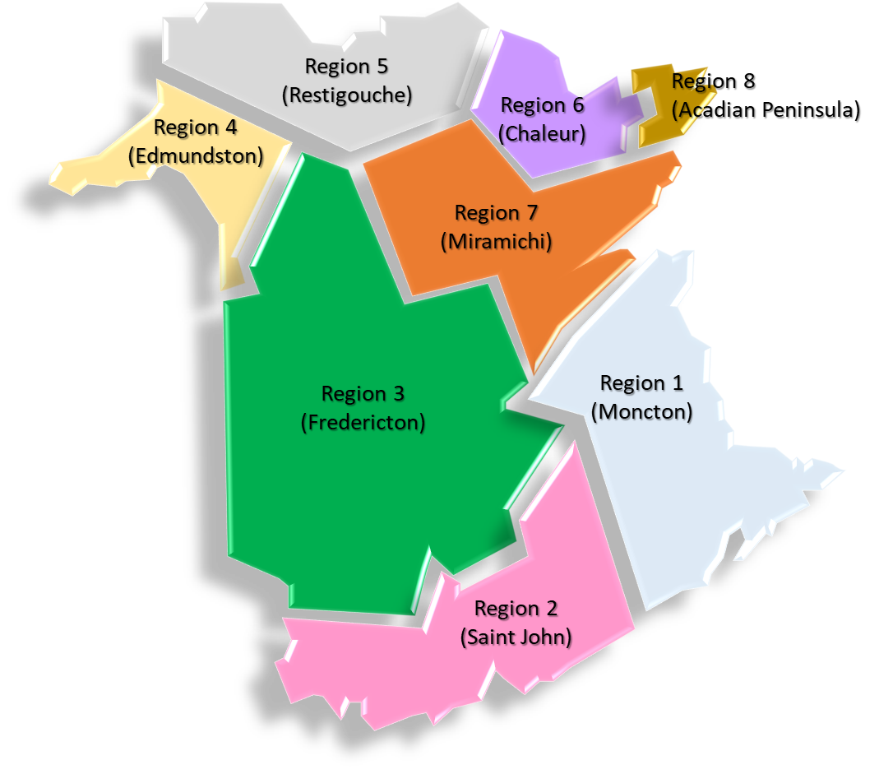
The NB Long-Term Care Landscape
The Breakdown of New Brunswick Nursing Homes
71 LTC Facilities – 8 Regions.
82% (99 beds or less).
15% (100 to 200 beds).
3% (200+ beds).
88% private, not-for profit
12% private, for profit.
Only in NB are 100% of LTC facilities privately owned.
Approximately 4900-5000 beds

Slide 71
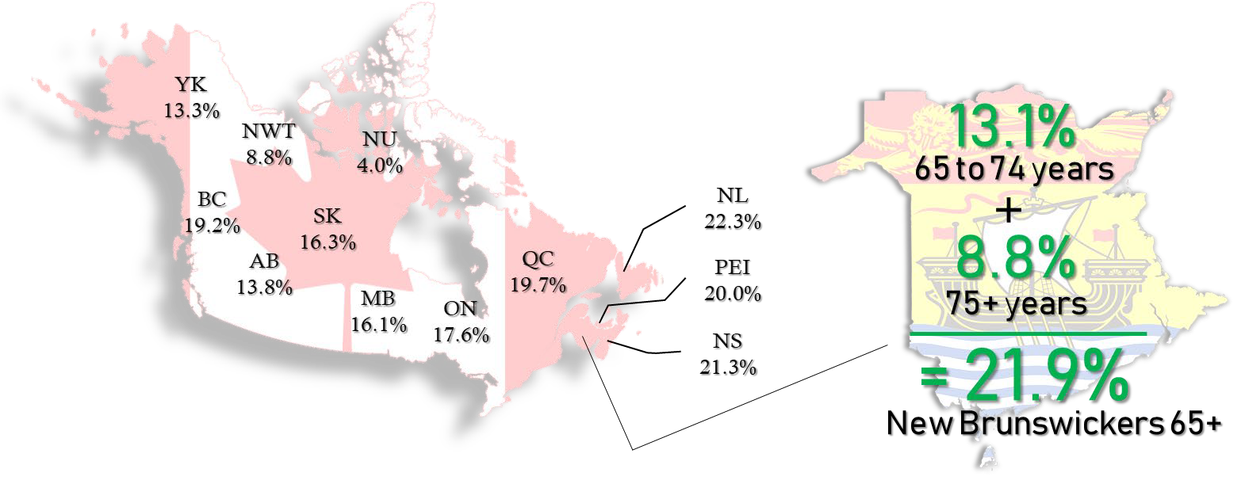
The NB Long-Term Care Landscape
New Brunswick Compared to Other Provinces

Slide 72
























The NB Long-Term Care Landscape
Region 3 Nursing Homes
York Care Centre | 218
Carleton Manor Inc. | 110
Shannex RLC Ltd. - Thomas Hall | 72
Pine Grove | 70
Mill Cove Nursing Home Inc. | 65
Victoria Glen Manor Inc. | 60
Orchard View | 40
River View Manor Inc. | 40
White Rapids Manor Inc. | 40
Shannex RLC Ltd. - Frederick Hall | 36
Wauklehegan Manor Inc. | 36
Central Carleton Nursing Home Inc. | 30
Central New Brunswick Nursing Home Inc. | 30
Nashwaak Villa Inc. | 30
Tobique Valley Manor Inc. | 30
W. G. Bishop Nursing Home | 30
Region 5 (Restigouche)
Region 8
(Acadian Peninsula)
Region 6 (Chaleur)
Region 4 (Edmundston)
Region 7 (Miramichi)
Region 3 (Fredericton)
Region 1 (Moncton)
Region 2 (Saint John)

Slide 73











The NB Long-Term Care Landscape
Low Growth Population Projections 75+
72,000
8.8%
Of Population
143,000
19.4%
Of Population

Slide 74
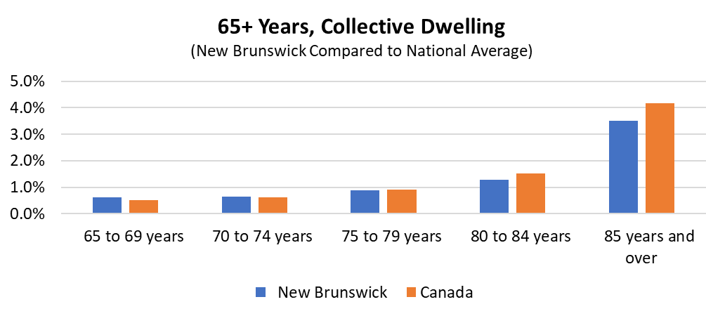
The NB Long-Term Care Landscape
% New Brunswickers Living in a Collective Dwelling
Collective Dwelling = nursing home, LTC, special care home, seniors residence, etc

Slide 75
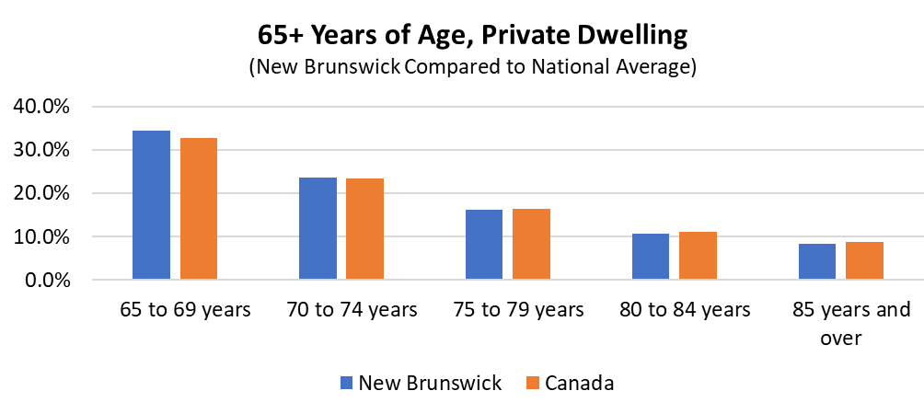
The NB Long-Term Care Landscape
% New Brunswickers Living in a Private Dwelling
Private Dwelling = living in own home, apartment, etc.

Slide 76


The NB Long-Term Care Landscape
Potential for Doubling of Beds, Costs
If nothing changes
The number of nursing home beds required is projected to increase from 5,000 to 10,000.
By 2043

Slide 77



The NB Long-Term Care Landscape
The Need for a New Model
June 2022
GNB announced that a new Long Term Care Plan would be developed.
Stakeholder consultations are underway
Possible Elements
Implications for York Care Centre
Independent Living for as long as possible
Accessible services which are easy to navigate
Continue to ensure quality long term care services
Strengthen Home Care
Leverage Community Services
Housing models which support independent living, including for those living with dementia
Workforce development
Ensuring our LTC services are not forgotten in the rush to develop community-based services.
Consider if we wish to take a larger role in providing community-based services, including home care
Consider the evolution of our independent housing program.
Consider further site development.
Consider a role in workforce development

